Slide 1


Set Theory and Venn diagram Session No.: Course Name: Course Code: O1UA422L Instructor Name: Duration: 50 Mins Date of Conduction of Class:

Slide 2

Learning Outcome:
Learning Outcome 1: Define and classify sets, subsets, and universal sets.
Learning Outcome 2: Apply Venn diagrams to solve real-world and exam-related problems.

Slide 3
Sets:
Definition :- A set is a well-defined collection of objects.
“The elements of a set are the objects in a set.”
Notation:- Usually we denote sets with upper-case letters, elements with lower-case letters. The following notation is used to show set membership.
x ∈ A means that x is a member of the set A.
x∉ A means that x is not a member of the set A.

Slide 4
Ways of Describing Sets
There are two methods of representing a set :
(i) Roster or tabular form
(ii) Set-builder form
In roster form, all the elements of a set are listed, the elements are being separated by commas and are enclosed within braces { }. The number of elements in a set is called its cardinal number.
Ex. The set of all natural numbers which divide 42 is {1, 2, 3, 6, 7, 14, 21, 42}.
(ii) In set-builder form, all the elements of a set possess a single common property which is not possessed by any element outside the set.
Ex. V = {x : x is a vowel in English alphabet}

Slide 5
Types of Sets
The sets are further categorised into different types, based on elements or types of elements.
Finite set: The number of elements is finite
Infinite set: The number of elements are infinite
Empty set: It has no elements
Singleton set: It has one only element
Equal set: Two sets are equal if they have same elements
Equivalent set: Two sets are equivalent if they have same number of elements i.e. their cardinal number is same.
Universal set: Any set that contains all the elements of all the subsets under consideration.

Slide 6
Membership Relationships
Subset :- “A is a subset of B” A ⊂B
We say “A is a subset of B” if x ∈ A => x ∈ B , i.e., all the members of A are also members of B. The notation for subset is very similar to the notation for “less than or equal to,” and means, in terms of the sets, “included in or equal to.”
Proper Subset :- “A is a proper subset of B” A ⊆ B
We say “A is a proper subset of B” if all the members of A are also members of B, but in addition there exists at least one element c such that c ∈ B but c ∉ A . The notation for subset is very similar to the notation for “less than,” and means, in terms of the sets, “included in but not equal to.”

Slide 7
Combining Sets – Set Union and Intersection
A U B :-
“A union B” is the set of all elements that are in A, or B, or both.
This is similar to the logical “or” operator.
A∩B :-
“A intersect B” is the set of all elements that are in both A and B.
This is similar to the logical “and”.

Slide 8
Set Theory Formulas
n( A ∪ B ) = n(A) +n(B) – n (A ∩ B)
n(A∪B)=n(A)+n(B) {when A and B are disjoint sets}
n(A−B)=n(A∩B)−n(B)
n(A−B)=n(A)−n(A∩B)
n(PUQUR)=n(P)+n(Q)+n(R)–n(P⋂Q)–n(Q⋂R)–n(R⋂P)+n(P⋂Q⋂R)

Slide 9
Question
Q1. Let A = { 2, 4, 6, 8} and B = { 6, 8, 10, 12}. Find A ∪ B
Ans. A ∪ B = { 2, 4, 6, 8, 10, 12}
Q.2 Let A = { 2, 4, 6, 8} and B = { 6, 8, 10, 12}. Find A ∩ B
Ans. A ∩ B = { 6, 8 }.
Q.3 Let A = { 1, 2, 3, 4, 5, 6}, B = { 2, 4, 6, 8 }. Find A – B and B – A
Ans. A – B = { 1, 3, 5 }
B – A = { 8 }

Slide 10
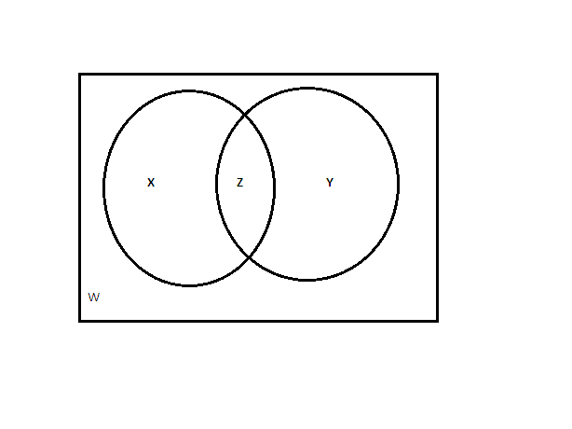
Venn diagram of two elements:
X = number of elements that belong to set A only Y = number of elements that belong to set B only Z = number of elements that belong to set A and B both W = number of elements that belong to none of the sets A or B From the above figure, it is clear that n(A) = x + z ; n (B) = y + z ; n(A ∩ B) = z; n ( A ∪ B) = x +y+ z. Total number of elements = x + y + z + w

Slide 11
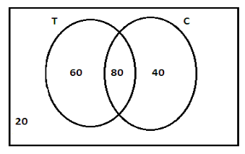
Example:
he given information may be represented by the following Venn diagram, where T = tea and C = coffee.
Number of students who like only tea = 60
Number of students who like only coffee = 40
Number of students who like neither tea nor coffee = 20
Number of students who like only one of tea or coffee = 60 + 40 = 100
Number of students who like at least one of tea or coffee = n (only Tea) + n (only coffee) + n (both Tea & coffee) = 60 + 40 + 80 = 180

Slide 12
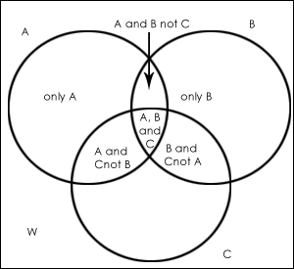
Venn diagram of 3 elements:
Only C
Where, W = number of elements that belong to none of the sets A, B or C

Slide 13
Example : In a survey of 500 students of a college, it was found that 49% liked watching football, 53% liked watching hockey and 62% liked watching basketball. Also, 27% liked watching football and hockey both, 29% liked watching basketball and hockey both and 28% liked watching football and basket ball both. 5% liked watching none of these games.
1. How many students like watching all the three games?
2. Find the ratio of number of students who like watching only football to those who like watching only hockey.
3. Find the number of students who like watching only one of the three given games.
4. Find the number of students who like watching at least two of the given games.

Slide 14
n(F) = percentage of students who like watching football = 49% n(H) = percentage of students who like watching hockey = 53% n(B)= percentage of students who like watching basketball = 62%
n ( F ∩ H) = 27% ; n (B ∩ H) = 29% ; n(F ∩ B) = 28%
Since 5% like watching none of the given games so, n (F ∪ H ∪ B) = 95%.
Now applying the basic formula, 95% = 49% + 53% + 62% -27% - 29% - 28% + n (F ∩ H ∩ B) Solving, you get n (F ∩ H ∩ B) = 15%.

Slide 15
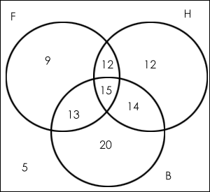
Number of students who like watching all the three games = 15 % of 500 = 75.
Ratio of the number of students who like only football to those who like only hockey = (9% of 500)/(12% of 500) = 9/12 = 3:4.
The number of students who like watching only one of the three given games = (9% + 12% + 20%) of 500 = 205
The number of students who like watching at least two of the given games=(number of students who like watching only two of the games) +(number of students who like watching all the three games)= (12 + 13 + 14 + 15)% i.e. 54% of 500 = 270.
Note: All values in the Venn diagram are in percentage.

Slide 16
Practice Questions
Notes:
57, 3, 42

Slide 17
1. In a class of 60 students, 40 play cricket, 32 play football, and 15 play both. Find the number of students who play
i) at least one
ii) none
iii) exactly one, of the two sports.
Notes:
57, 3, 42

Slide 18
2. In a group, 70% read TOI, 50% read IE,15% read neither of the two. Find the percent of people who read both the newspaper.
a) 15 b) 35 c) 55 d) 70
Notes:
B

Slide 19
3. Among a group of men, 80 are happy, 50 are married, 30 are happily married and 20 are neither married nor happy. How many in the group are unmarried.
a) 20 b) 50 c)70 d) 80
Notes:
C

Slide 20
4. In a group of 50 people, 35 drink tea, 25 drink coffee. How many drink both.
a) 10 b) 15 c) 25 d) CANNOT BE DETERMINED
Notes:
D

Slide 21
5. In a group, 80 people have watched Piku or Krish, 32 people have watched Piku and Krish. If 50 people have NOT watched Piku, 30 people have not watched Krish, find the no. of people who have watched neither Piku nor Krish.
a) 16 b) 66 c)80 d)96
Notes:
A

Slide 22
6. In a science school a student has an option to drop maths or drop biology but he cannot drop both the subjects. 50 students dropped Maths, 30 dropped Biology, whereas 20 opted to study both the subjects. Find the class strength.
a) 50 b)80 c)100 d)120
Notes:
C

Slide 23
7. 95% of the students in a class have taken Marketing, 80% have chosen Finance, 84% have chosen Operations (ops), and 90% have chosen Human Resources (HR). What is the maximum and minimum percentage of people who have chosen all of the four?
a. 80% and 56% b. 95% and 53%
c. 80% and 49% d. 80% and 51%
Notes:
C

Slide 24
DIRECTION FOR QUESTION (8 To 14) : In a survey among students at all the IIMs, it was found that 48% preferred coffee, 54% liked tea and 64% smoked. Of the total, 28% liked coffee and tea, 32% smoked and liked tea, 30% smoked and preferred coffee. Only 6% did none of these. The total number of students is 2000.
8. The ratio of the number of students who like only coffee to the number who like only tea is
a) 5 :3 b) 8 :9 c) 2:3 d) 3:2
Notes:
C

Slide 25
DIRECTION FOR QUESTION (8 To 14) : In a survey among students at all the IIMs, it was found that 48% preferred coffee, 54% liked tea and 64% smoked. Of the total, 28% liked coffee and tea, 32% smoked and liked tea, 30% smoked and preferred coffee. Only 6% did none of these. The total number of students is 2000.
9. The number of students who preferred coffee and smoking but not tea is
a) 600 b) 240 c) 280 d) 360
Notes:
B

Slide 26
DIRECTION FOR QUESTION (8 To 14) : In a survey among students at all the IIMs, it was found that 48% preferred coffee, 54% liked tea and 64% smoked. Of the total, 28% liked coffee and tea, 32% smoked and liked tea, 30% smoked and preferred coffee. Only 6% did none of these. The total number of students is 2000.
10. The percentage of those who preferred coffee or liked tea but not smoking among those who like at least one of these is
a) More than 30 b) Between 25 and 30 c) Exactly 30
d) Less than 25
Notes:
A

Slide 27
DIRECTION FOR QUESTION (8 To 14) : In a survey among students at all the IIMs, it was found that 48% preferred coffee, 54% liked tea and 64% smoked. Of the total, 28% liked coffee and tea, 32% smoked and liked tea, 30% smoked and preferred coffee. Only 6% did none of these. The total number of students is 2000.
11. The percentage of those who liked at least one of these is
a) 100 b) 90 c) Nil d) 94
Notes:
D

Slide 28
DIRECTION FOR QUESTION (8 To 14) : In a survey among students at all the IIMs, it was found that 48% preferred coffee, 54% liked tea and 64% smoked. Of the total, 28% liked coffee and tea, 32% smoked and liked tea, 30% smoked and preferred coffee. Only 6% did none of these. The total number of students is 2000.
12. The number of persons who like coffee and smoking but not tea and the number who like only coffee bear a ratio of
a) 1:2 b) 3:2 c) 5:1 d) 2:1
Notes:
B

Slide 29
DIRECTION FOR QUESTION (8 To 14) : In a survey among students at all the IIMs, it was found that 48% preferred coffee, 54% liked tea and 64% smoked. Of the total, 28% liked coffee and tea, 32% smoked and liked tea, 30% smoked and preferred coffee. Only 6% did none of these. The total number of students is 2000.
13. The two items having the ratio as 1:2 are
a) Tea only and tea and smoking only
b) Coffee and smoking only and tea only
c) Coffee and tea but not smoking and smoking but not coffee and tea
d) None of these
Notes:
C

Slide 30
DIRECTION FOR QUESTION (8 To 14) : In a survey among students at all the IIMs, it was found that 48% preferred coffee, 54% liked tea and 64% smoked. Of the total, 28% liked coffee and tea, 32% smoked and liked tea, 30% smoked and preferred coffee. Only 6% did none of these. The total number of students is 2000.
14. Percentage of those who like tea and smoking but not coffee is
a) 14 b) 14.9 c) Less than 14 d) More than 15
Notes:
A

Slide 31
15. Following is the data regarding the channels subscribed by 400 families in a locality, 180 subscribe Star, 200 subscribe Colors, 240 subscribe Sony, 100 subscribe Stars and Colors, 115 subscribe Colors and Sony, 105 subscribe Star and Sony. If the families subscribing to all three is equal to those subscribing to none of the three, find the numbers subscribing exactly 1.
a)50 b) 130 c)180 d)220
Notes:
B

Slide 32
16. In a survey done to study consumer preferences, the number of people who prefer Lux, Pears, and Dove are 160, 120, and 80 respectively. The number of people who liked exactly 2 out of 3 soaps is 60. And those who prefer at least 1 of the three is 250. Find the no. of people who liked all the three soaps.
a) 25 b)50 c)60 d)75
Notes:
A

Slide 33
17. In a group of tourists 90% visited at least 1 city out of Paris, London, or New York, 75% have visited 2 or more of these cities, 25% have visited all three cities. If 10% of the group have visited only London, 40% of the group visited Paris and New York, What % of the group did not visit London?
a) 45 b)30 c)70 d)85
Notes:
B

Slide 34
18. Of the 125 students of a school, 45 did not get a call from College A, 55 did not get a call from College B and 75 did not get a call from College C. Further, 30 got calls from A and B, 40 got calls from B and C, and 30 got calls from A and C. If 105 students did not get a call from at least one of these Colleges, find the number of students who got a call from
i) all 3
ii) None.
Notes:
20, 5

Slide 35
19. In a survey of 360 respondents, 150 prefer A, 250 prefer B, 200 prefer C, 100 prefer A and B, 120 prefer B and C, 80 prefer A and C. How many prefer all three?
a) 30 b)60 c)160 d)CANNOT BE DETERMINED
Notes:
D

Slide 36
20. A class had a strength of 40 students numbered from 1 to 40. Students with even roll numbers were doing English literature, while students with roll numbers in multiples of 4 were doing Fashion Design, and students with roll numbers in multiples of 8 were in the technical field. Calculate the number of students who opted for none of the three streams?
a. 20 b. 25 c. 30 d. 35
Notes:
A

Slide 37
Ensure attainment of LOs in alignment to the learning activities: outcomes (1-2)
Outcome 1: Students are able to understand and represent sets using diagrams.
Outcome 2: Students can apply Venn diagram concepts to solve problems involving union, intersection, and complements.

Slide 38
Information about the next lesson

Slide 39
Review and Reflection from students

Slide 40
THANK YOU

